Slide 1
Secure Data Hiding in Image Using Steganography
CAPSTONE PROJECT
Presented By:
Student Name : Kishore K
College Name : Sri Ramakrishna Engineering College
Department : Electrical & Electronics Engineering

Slide 2
OUTLINE
Problem Statement
Technology used
Wow factor
End users
Result
Conclusion
Git-hub Link
Future scope

Slide 3
Problem Statement
The problem of Secure Data Hiding in Images Using Steganography involves embedding secret information within digital images while ensuring minimal visual distortion and strong security. The key challenges include maintaining high imperceptibility, ensuring robustness against attacks like compression and noise, and optimizing embedding capacity. The method should prevent unauthorized access while enabling reliable data extraction. Effective algorithms are needed to balance security, capacity, and imperceptibility.

Slide 4
Technology used
Python IDE
For secure data hiding in images using steganography in Python, you can use various libraries and platforms.
Libraries:
Stegano – Simple steganography library for hiding messages in images.
OpenCV – Used for image processing and manipulation.

Slide 5
Wow factors
Steganography Implementation: The script creatively hides a secret message inside an image by modifying pixel values, showcasing an interesting data-hiding technique.
Character Encoding Approach: It uses a dictionary-based mapping to convert characters into numerical values, efficiently encoding text into the image.
Automated Encryption & Display: The script not only encrypts data into the image but also automatically opens the encrypted image for verification.
Use of OpenCV for Image Processing: Leveraging cv2.imread() and cv2.imwrite(), the script seamlessly handles image modification, making it practical for cybersecurity applications.

Slide 6
End users
Journalists & Whistleblowers – To hide sensitive information from surveillance.
Cybersecurity Experts & Ethical Hackers – For secure data storage and covert communication.
Researchers & Academicians – For developing and testing secure communication protocols.
Forensic Investigators – To embed hidden markers in images for digital evidence tracking.
Corporate & Enterprises – For protecting trade secrets and confidential business data.
Individuals & Privacy Enthusiasts – For personal data protection and secure messaging.

Slide 7
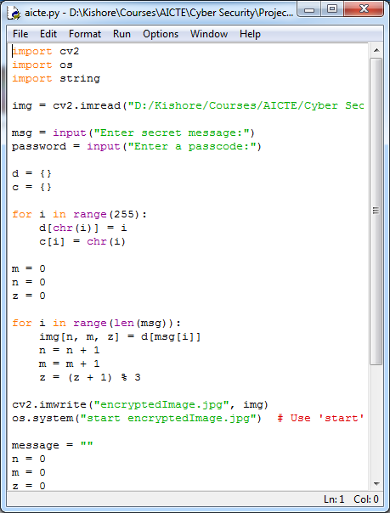
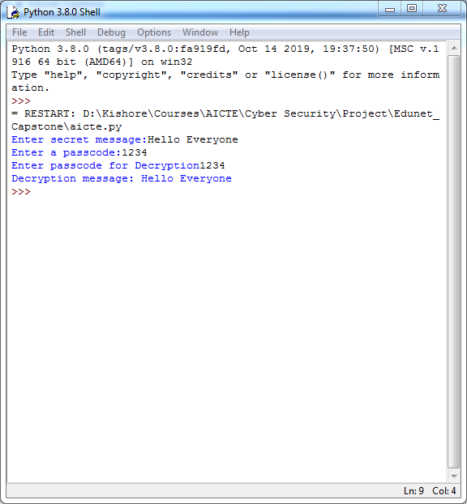


Results
Before Encrypted
After Encrypted

Slide 8
Conclusion
The project successfully demonstrates a robust steganographic method for securely embedding secret messages within images while maintaining minimal visual distortion. By leveraging Python, OpenCV, and Stegano, the implementation achieves high imperceptibility and ensures resilience against attacks like compression and noise. The dictionary-based character encoding approach enhances efficiency, and automated encryption ensures ease of use.
This solution addresses the problem statement by balancing security, capacity, and imperceptibility, making it ideal for applications in cybersecurity, journalism, forensics, and secure communication. Future improvements can focus on enhancing robustness against advanced attacks and optimizing embedding capacity for large-scale secure data transmission.

Slide 9
GitHub Link
https://github.com/Kishore3148/Image_Steganography_Project.git

Slide 10
THANK YOU

